Slide 1

Class 5 – Logistic Regression Classification
Pedram Jahangiry
Fall 2019

Slide 2
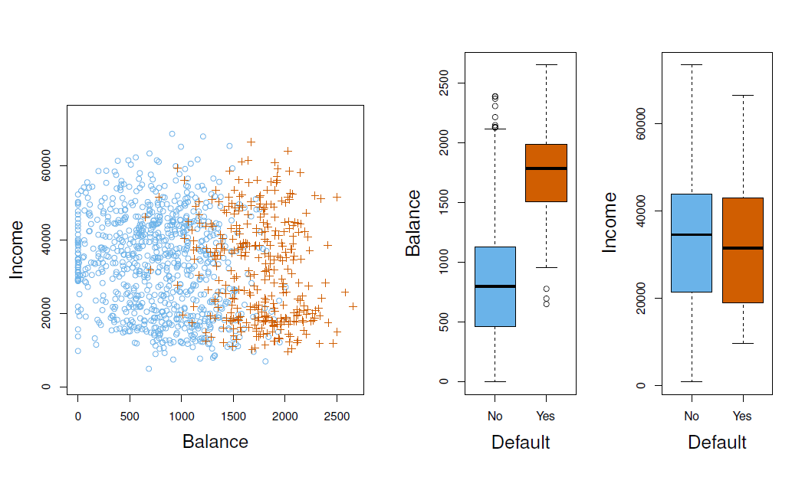
Credit Card Default

Slide 3
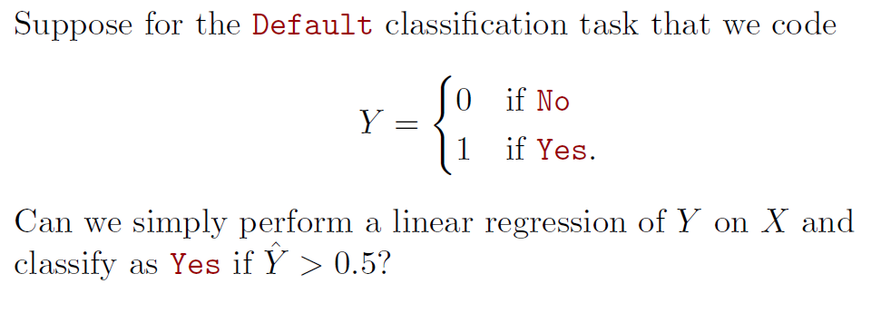
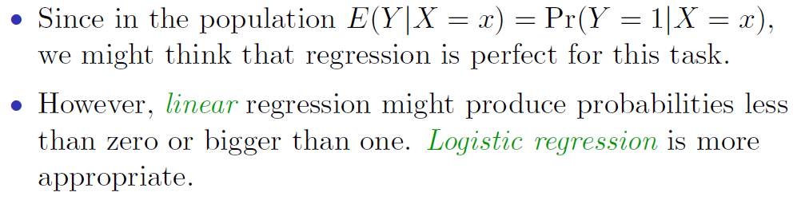
Can we use linear probability model (LPM)?

Slide 4
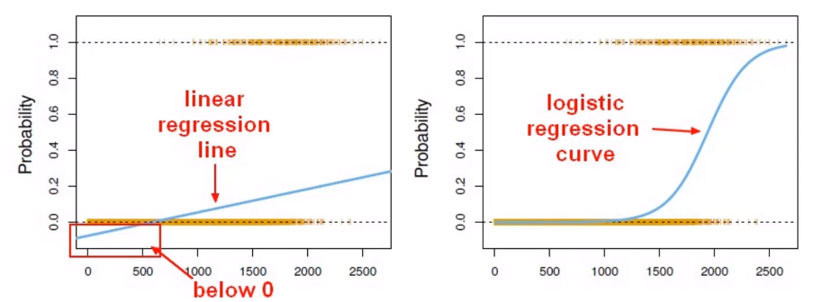
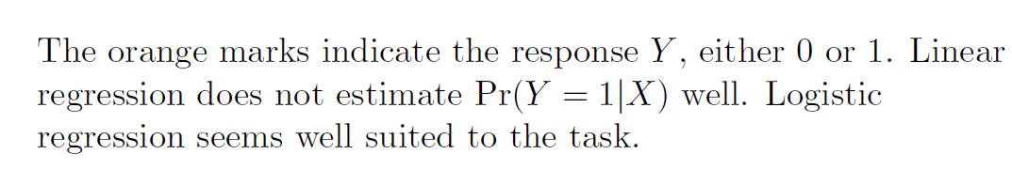
Linear versus Logistic Regression
Notes:
We need a mapping function that is between 0 and 1.
It is monotone

Slide 5
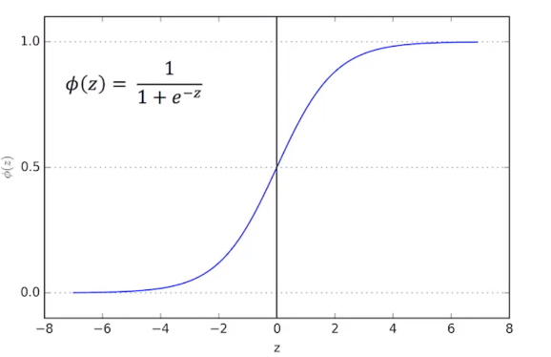
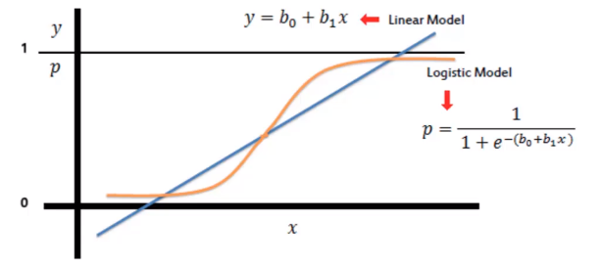
Sigmoid Function
The Sigmoid (aka Logistic) function has a range of [0,1]

Slide 6
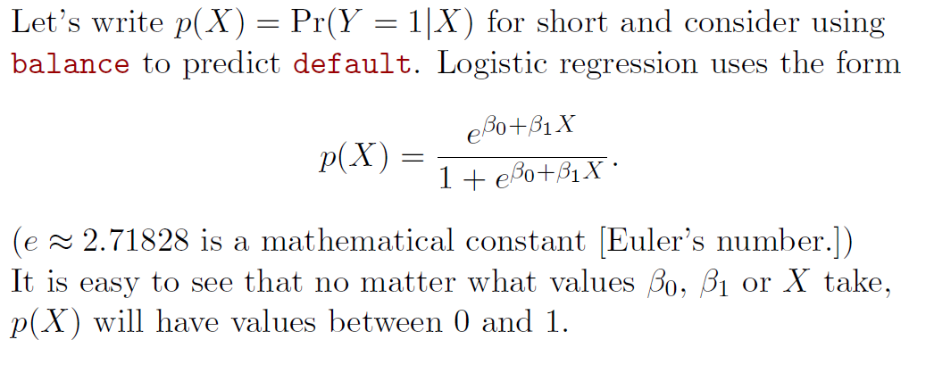
Logistic Regression

Slide 7
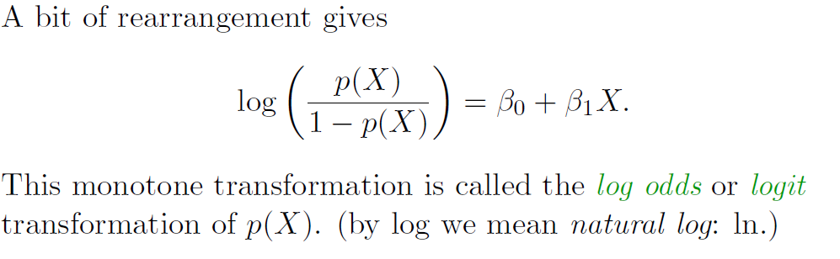
Logistic Regression (cont’d)
Logistic regression ensures that our estimate for p(X) lies between 0 and 1.
Logistic regression is very popular for classification, especially when K = 2

Slide 8
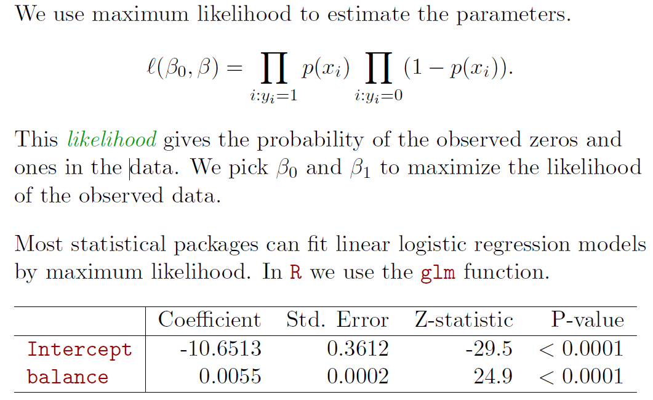
Maximum Likelihood

Slide 9
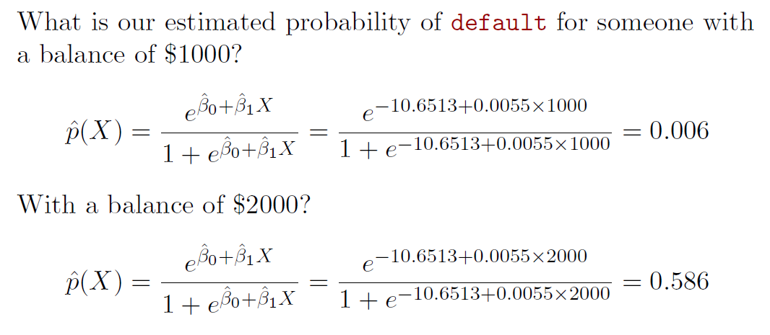
Predictions

Slide 10
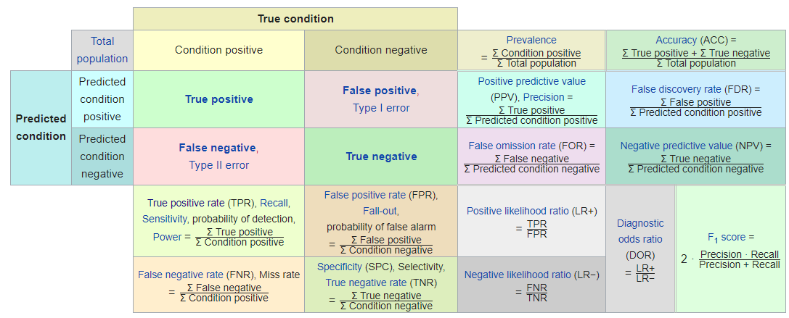
Other measures

Slide 11

Types of errors

